Slide 1
Limerick book
By Radvilė Spiridonovaitė

Slide 2
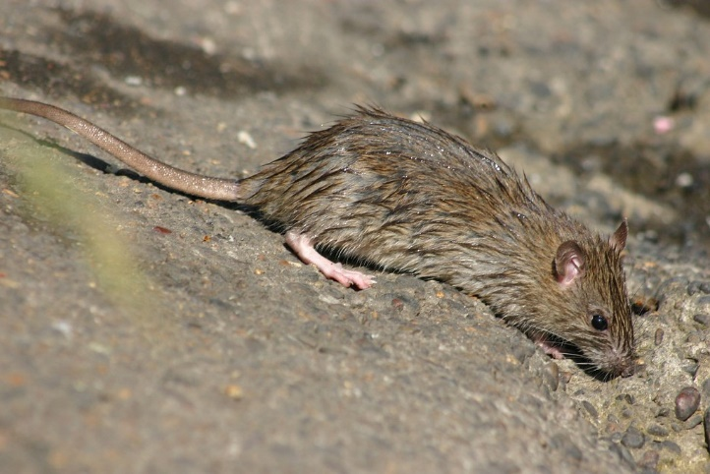
Once there was a pretty mouse
Once there was a pretty mouse
It went out of the house
Whether wanted to play
So it started to rain
Now there’s a rat that is scared of meows

Slide 3
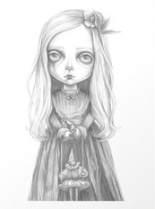
Little girl liked to play around
Little girl liked to play around
Somehow she fell on the ground
Mother took her to bed
But the girl was already dead
Now in the house lives a ghost unfound

Slide 4
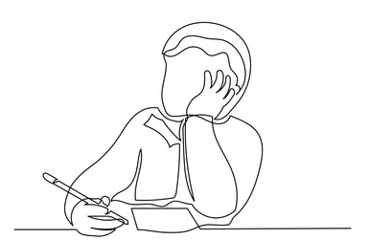
A boy wanted to re-write the test
A boy wanted to re-write the test
Because his grades weren’t the best
He wouldn’t shut his mouth
So the grade went south
The teacher isn’t impressed.

